Slide 1
PlanetM
(Music Player)
Group :- G7-Angular

Slide 2
Mentor and Team Members
Mentor :- Vignan Gajula
Team Members :-
Nikhil Bharatlal Bisen
Nirajkumar Sureshrao Ablankar
Nitin Surendra Wandile
Onkar Raju. Hongekar
Prafull Dhanraj Shindekar
Pranit Ravikant Dhage
Pranita Suresh Salunke

Slide 3
Github Link
https://github.com/CDAC-FET-July21/MiniProject_G7_Angular
SonarQube Link
http://172.27.12.78/overview?id=MiniProject_G7_Angular

Slide 4
Members Contribution
Name | Contribution
Nikhil Bharatlal Bisen | Audio panel
Nirajkumar Sureshrao Ablankar | Database, Profile page, Playlist, Update Password
Nitin Surendra Wandile | Audio panel
Onkar Raju. Hongekar | Music library
Prafull Dhanraj Shindekar | Home, Navbar, Footer
Pranit Ravikant Dhage | Choose Language, Database, GitHub, SonarQube
Pranita Suresh Salunke | Login & Registration with validations, JSON Server

Slide 5
Agenda
Background Research
Scope & Objective
Operating Environment

Slide 6
Background Research
While staring the work on UI, we visited some famous music application for various ideas and to understand their working logic.
Following music applications we referred for PlanetM UI
Saavn
Spotify
Gaana

Slide 7
Scope & Objective
To create a music application with simple and elegant UI with latest songs.
Option to choose between multiple languages such as Marathi, Hindi and English.
Various album categories are available like rock jazz bollywood which helps the user to enjoy the music as per their wish.
We have clubbed all the songs into a playlist where user doesn’t have to keep playing next songs.
Availability of customized playlist such as Trending songs, Top Ten Songs.
Accessibility of content to only registered users.
Facility of profile updation for registered users.

Slide 8
Operating Environment
Support any browser
Compatible with windows and android environment
Mobile friendly
Technologies:
HTML
SASS, Bootstrap
jQuery, JSON-server
SonarQube
GitHub

Slide 9
Project Introduction
PlanetM is simple but elegant music application.
It has descent UI and you will have no problems getting around and listening to music.
In PlanetM you can choose between Marathi, English and Hindi songs to listen to.
There are various categories such as Trending music, Recently played songs.
You need to have an account to explore PlanetM. After successful registration, there is an option to update your profile as well.

Slide 10
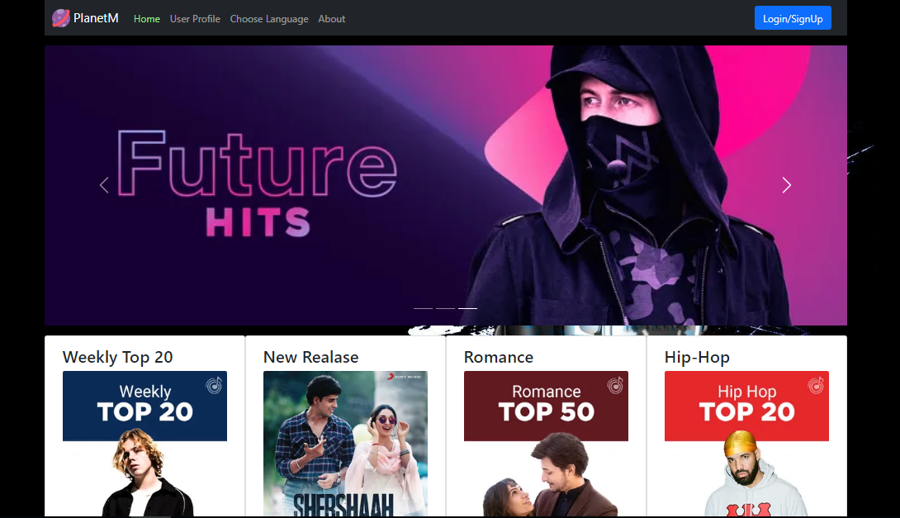
Homepage
Referene layout for new topic slide
Option 1 – with multiple images
Copyright © 2021 Cybage Software Pvt. Ltd. All Rights Reserved. Cybage Confidential.
www.cybage.com

Slide 11
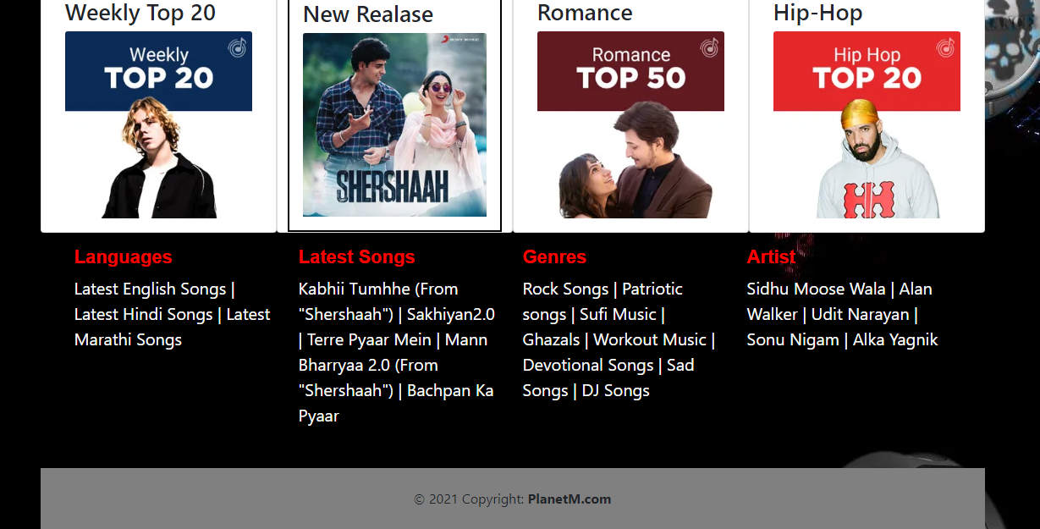
Homepage
Referene layout for new topic slide
Option 1 – with multiple images
Copyright © 2021 Cybage Software Pvt. Ltd. All Rights Reserved. Cybage Confidential.
www.cybage.com

Slide 12
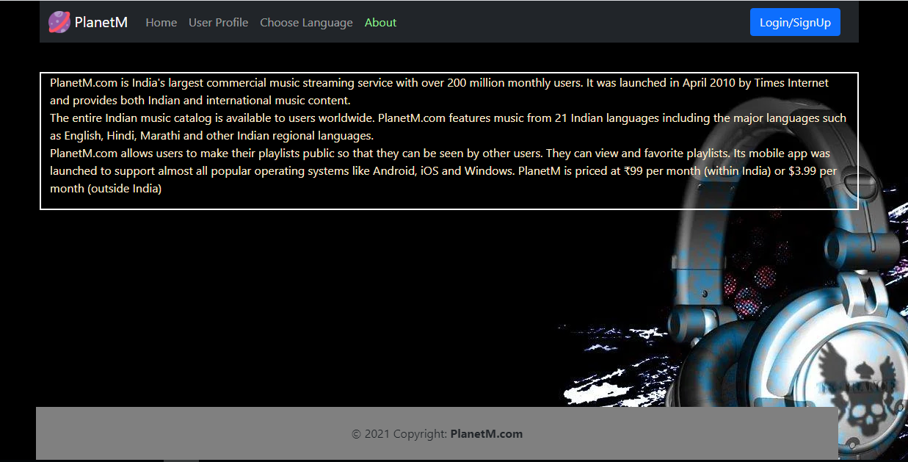
About
Referene layout for new topic slide
Option 1 – with multiple images
Copyright © 2021 Cybage Software Pvt. Ltd. All Rights Reserved. Cybage Confidential.
www.cybage.com

Slide 13
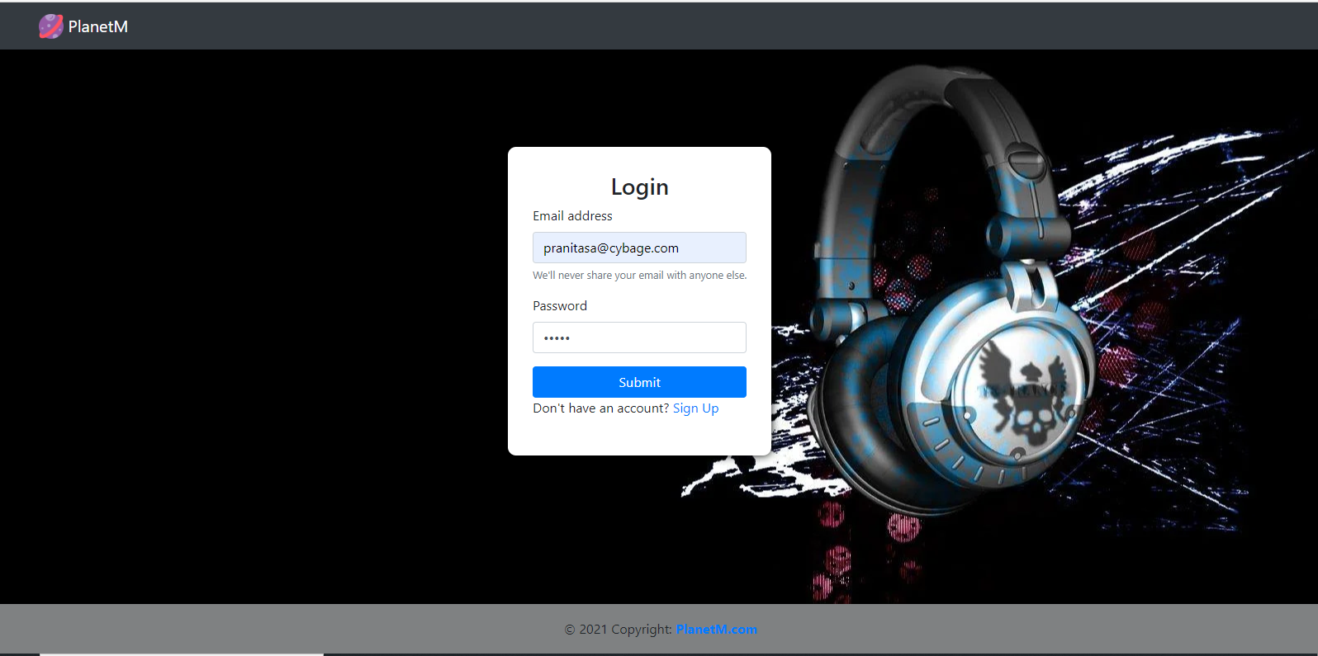
Login
Reference layout for new topic slide
Option 1 – with multiple images
Copyright © 2021 Cybage Software Pvt. Ltd. All Rights Reserved. Cybage Confidential.
www.cybage.com

Slide 14
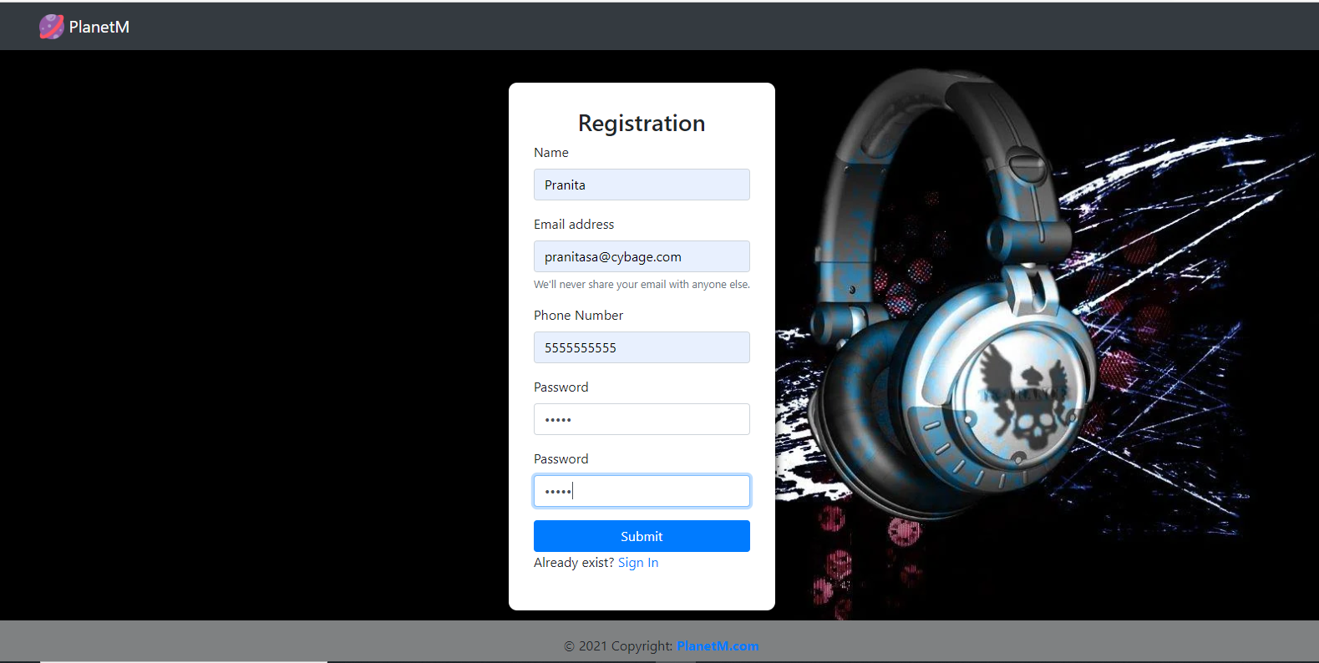
Registration
Copyright © 2021 Cybage Software Pvt. Ltd. All Rights Reserved. Cybage Confidential.
www.cybage.com

Slide 15
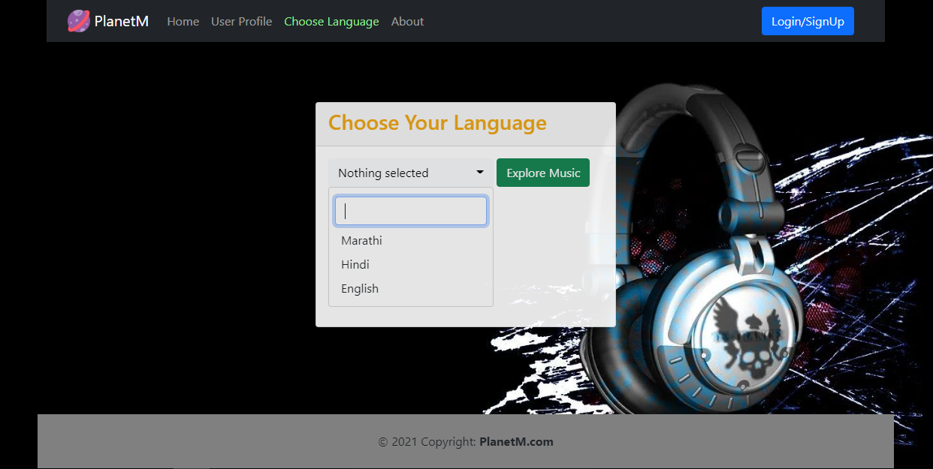
Choose Language
Copyright © 2021 Cybage Software Pvt. Ltd. All Rights Reserved. Cybage Confidential.
www.cybage.com

Slide 16
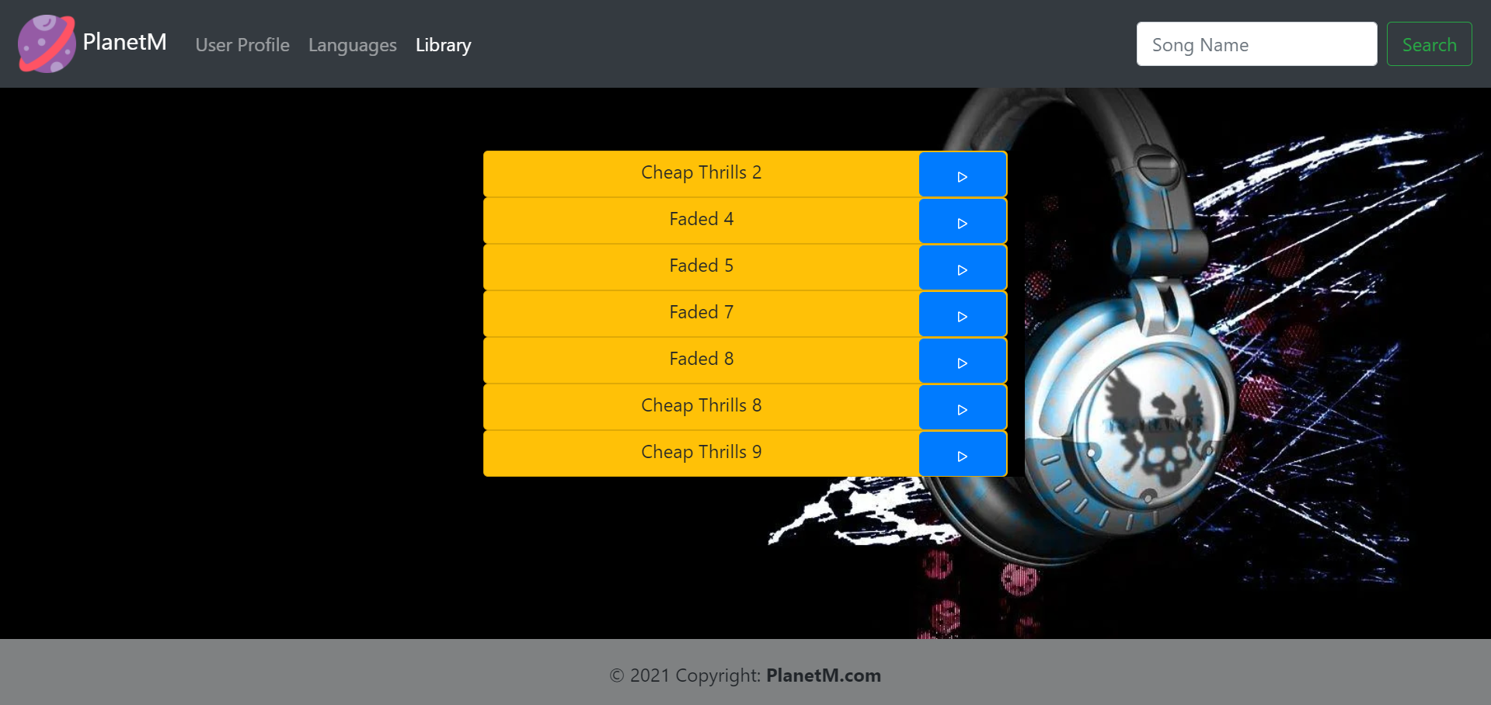
Music Library
Copyright © 2021 Cybage Software Pvt. Ltd. All Rights Reserved. Cybage Confidential.
www.cybage.com

Slide 17
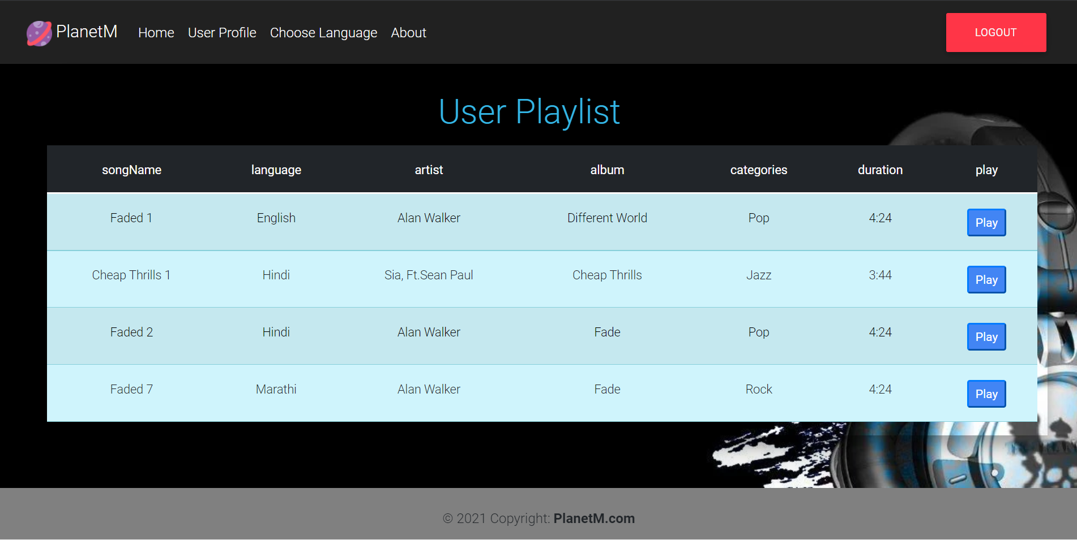
User Playlist
Copyright © 2021 Cybage Software Pvt. Ltd. All Rights Reserved. Cybage Confidential.
www.cybage.com

Slide 18
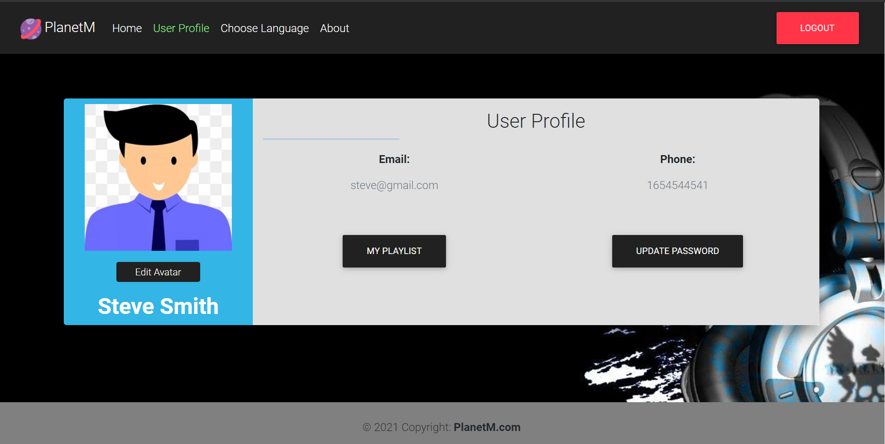
User Profile
Copyright © 2021 Cybage Software Pvt. Ltd. All Rights Reserved. Cybage Confidential.
www.cybage.com

Slide 19
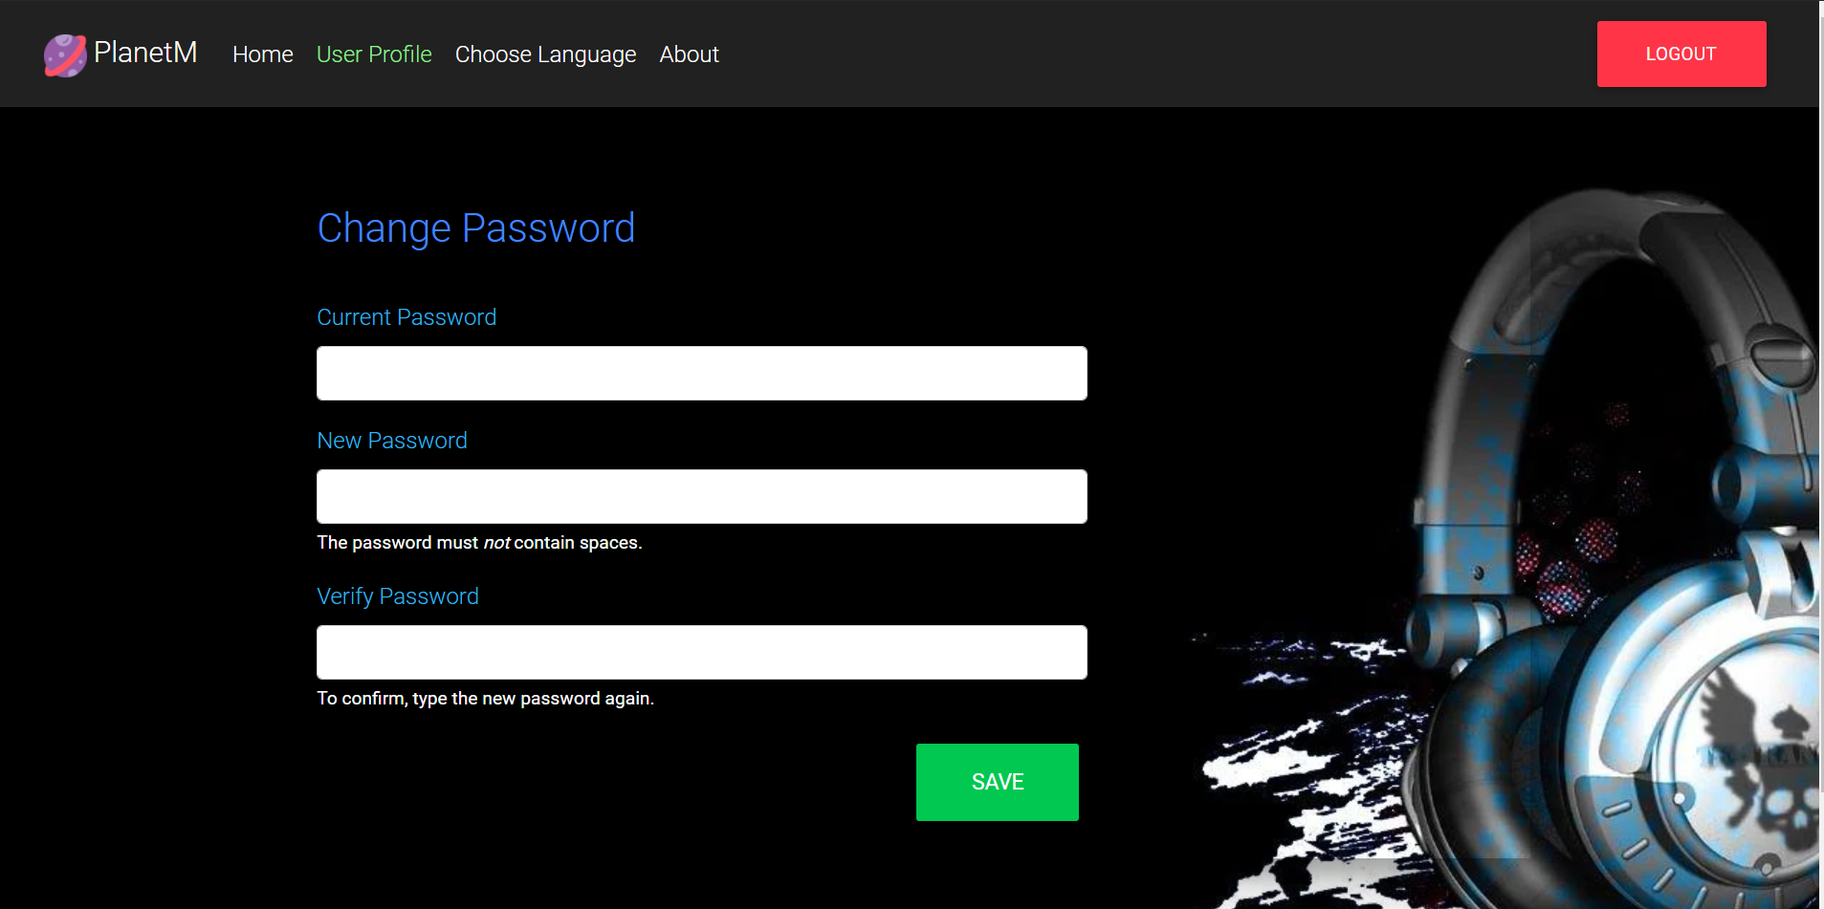
Update Password
Copyright © 2021 Cybage Software Pvt. Ltd. All Rights Reserved. Cybage Confidential.
www.cybage.com

Slide 20
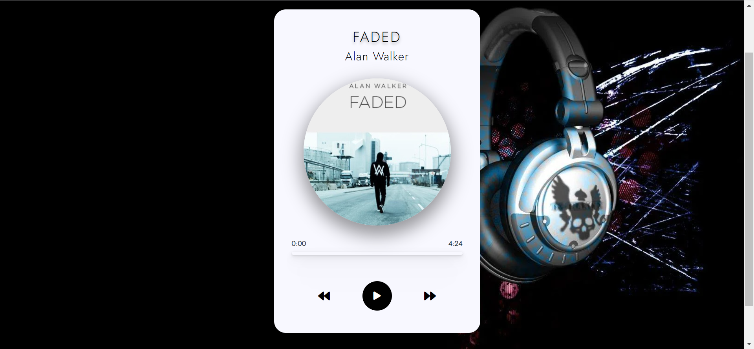
Music Player
Copyright © 2021 Cybage Software Pvt. Ltd. All Rights Reserved. Cybage Confidential.
www.cybage.com

Slide 21
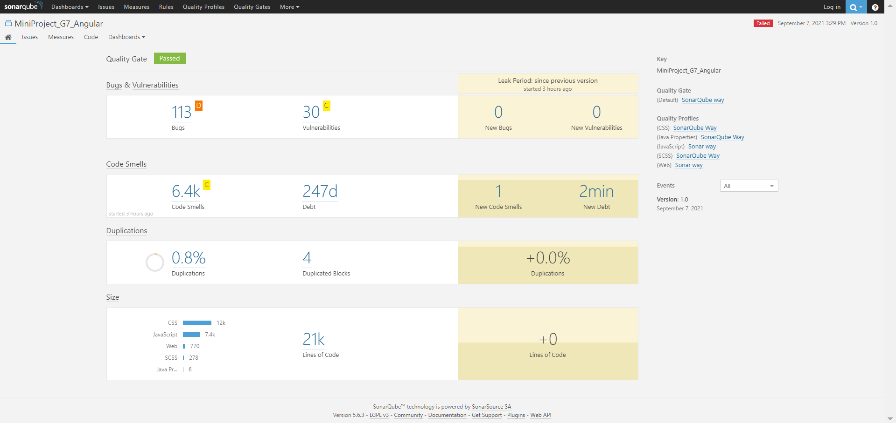
SonarQube
Copyright © 2021 Cybage Software Pvt. Ltd. All Rights Reserved. Cybage Confidential.
www.cybage.com

Slide 22
Thank You!

